Slide 1
SUPERVISED LEARNING

Slide 2
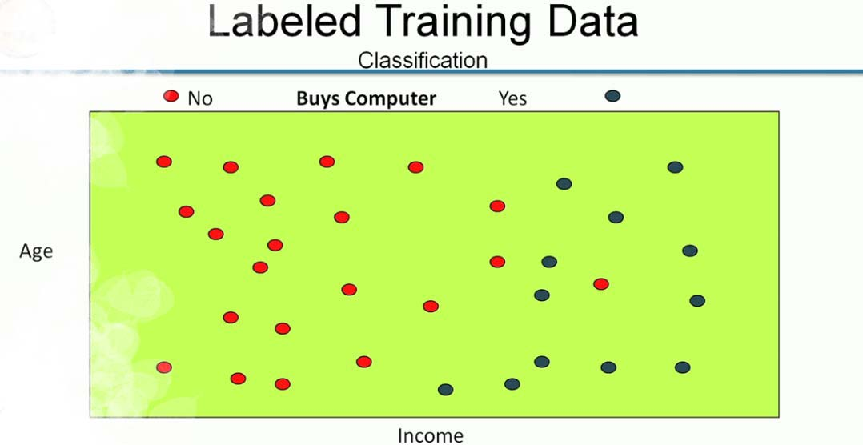

Slide 3
Input Data: Age and Income
Map
or
function
Buy a Computer

Slide 4
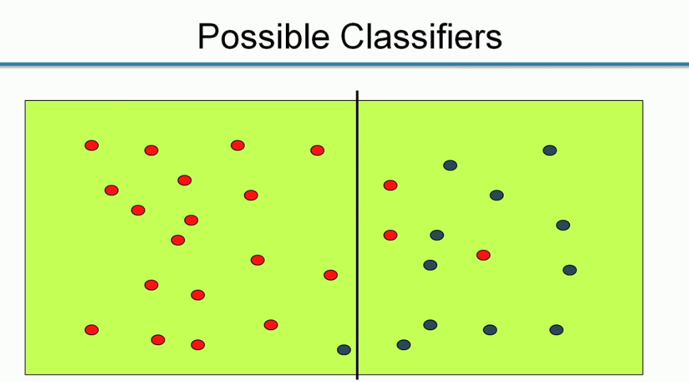
Age
Income

Slide 5
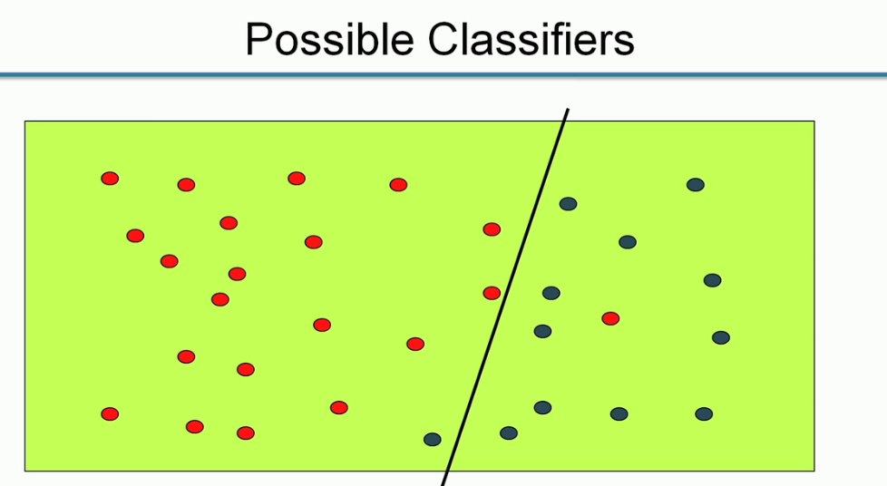
Age
Income

Slide 6
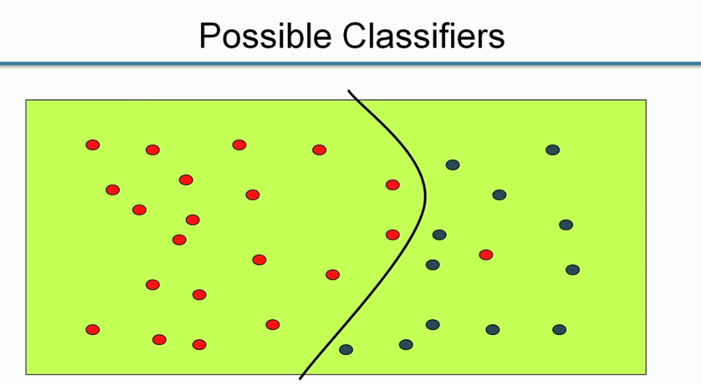
Age
Income

Slide 7
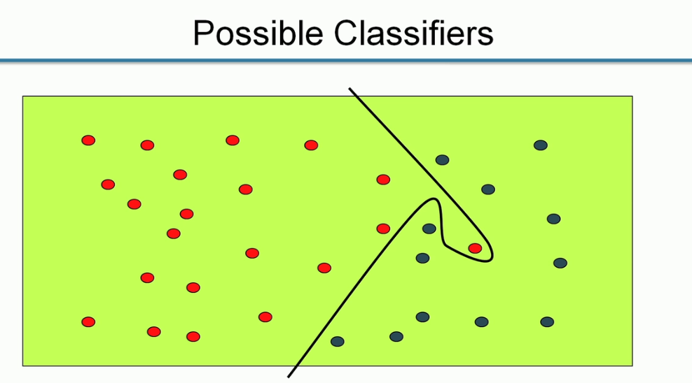
Age
Income

Slide 8
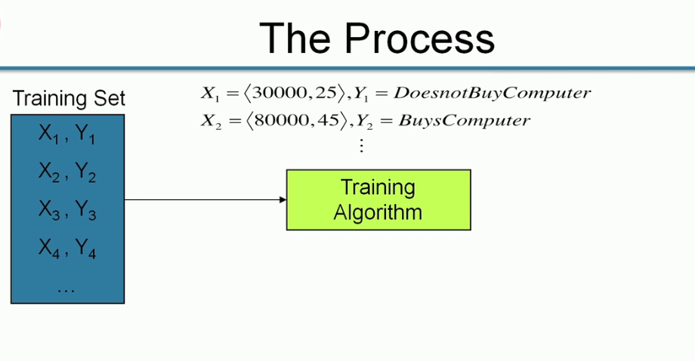

Slide 9
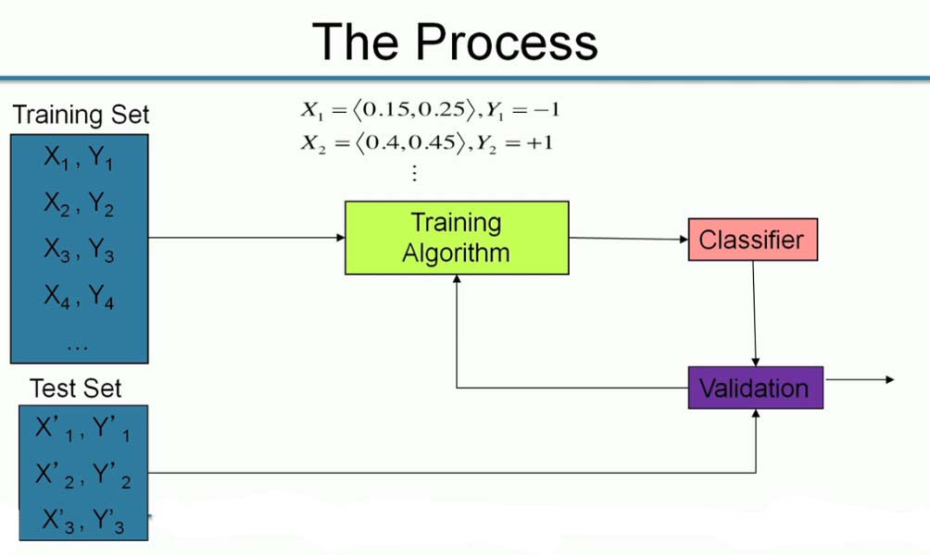

Normalize the input Data

Slide 10
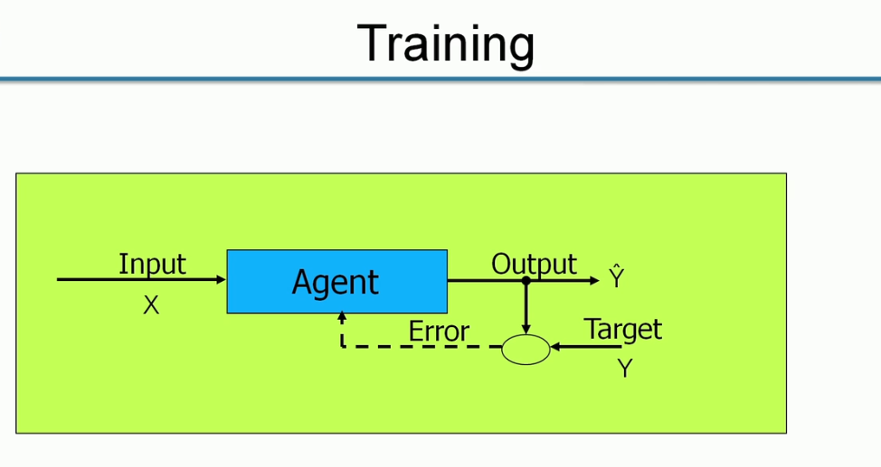

Slide 11
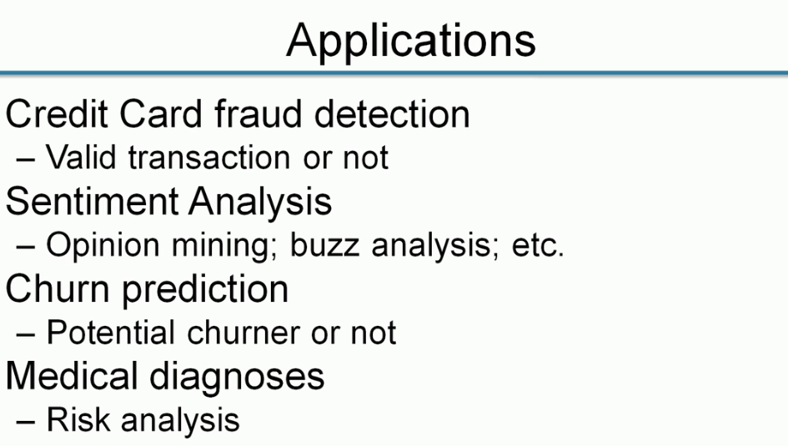

Slide 12
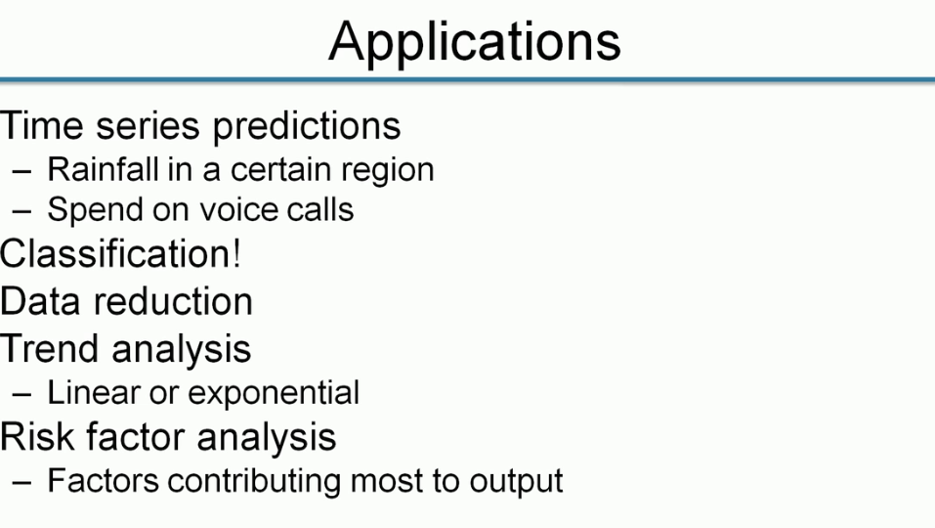

Slide 13
Jai Sairam

